Slide 1
What You Mark is What Apps See
Nisarg Raval, Animesh Srivastava, Ali Razeen,
Kiron Lebeck, Ashwin Machanavajjhala, Landon Cox
Duke University, University of Washington

Slide 2
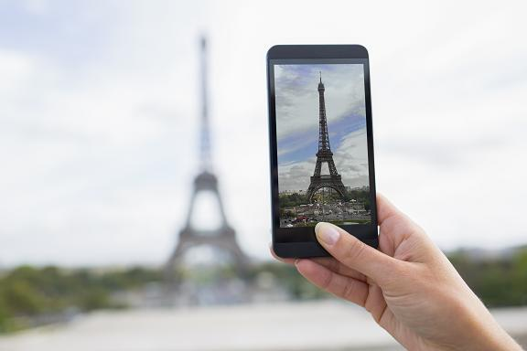
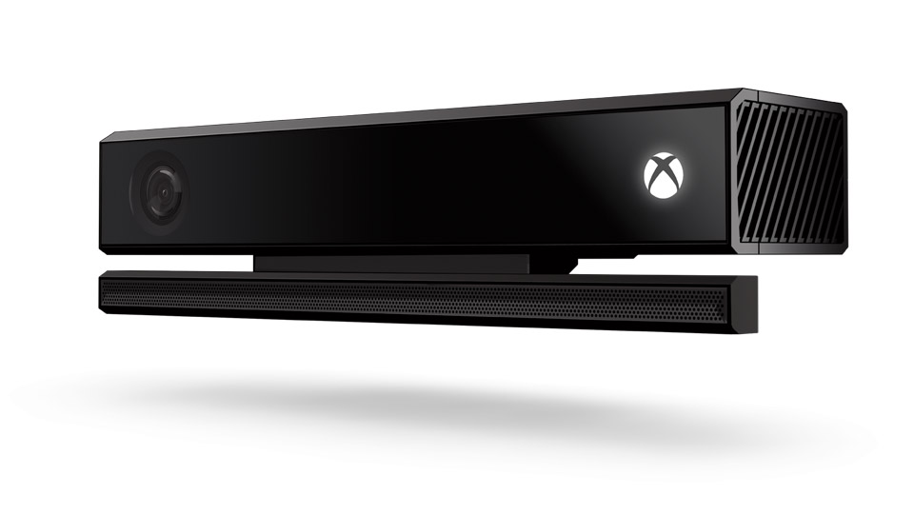
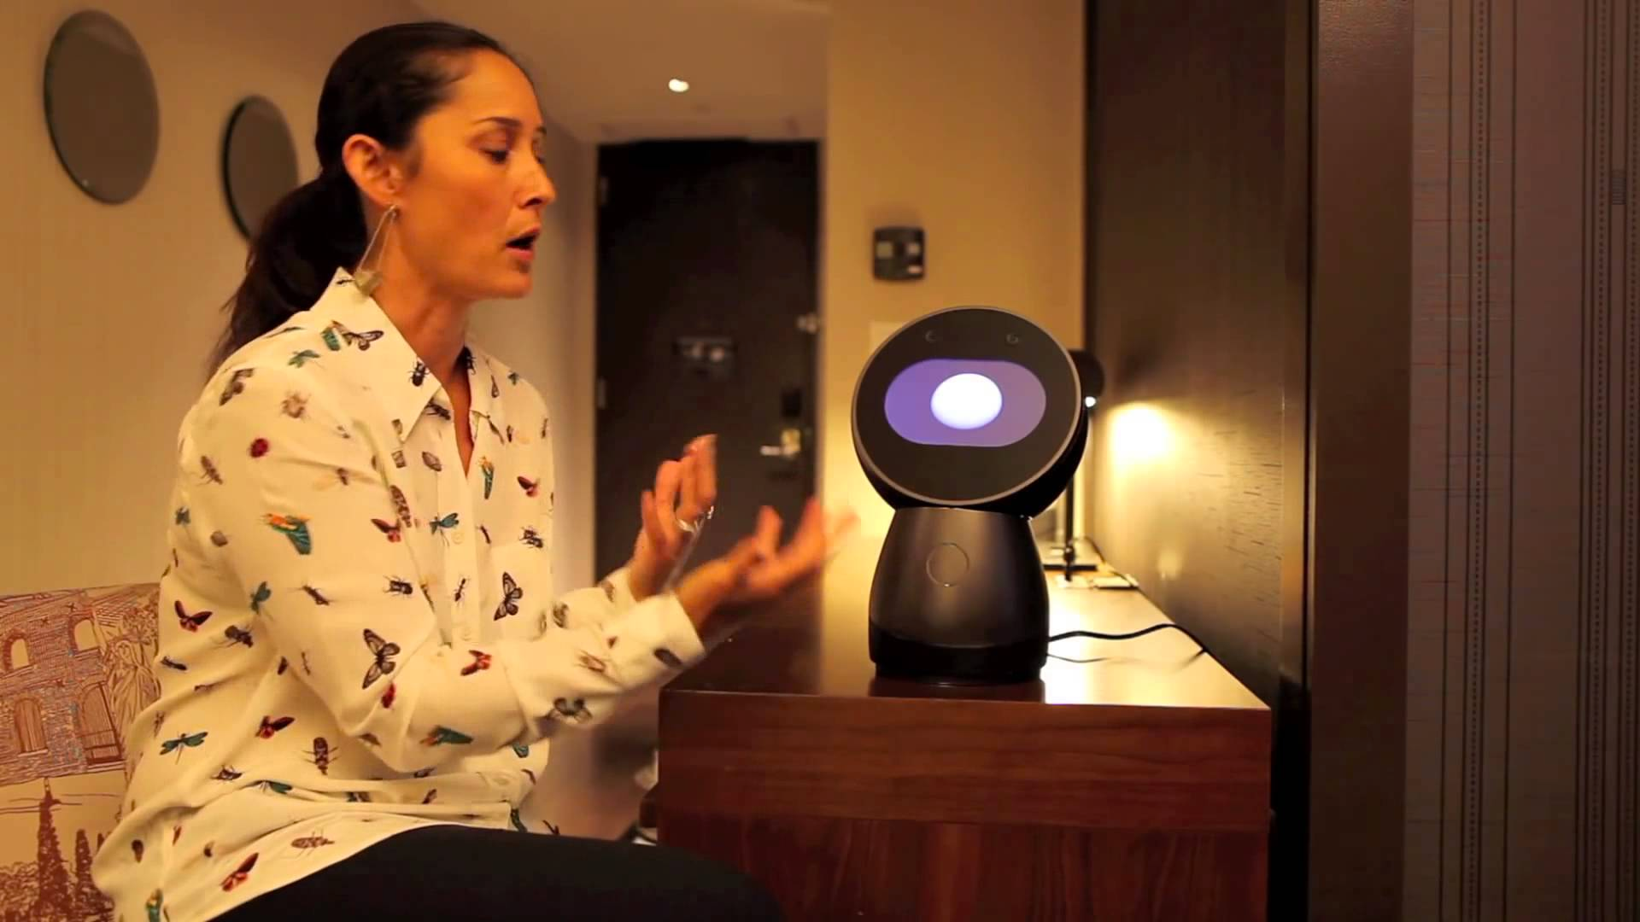
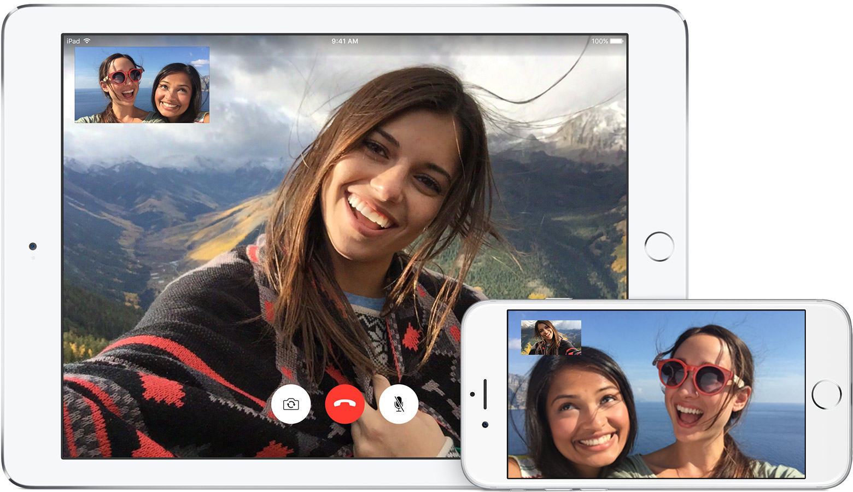
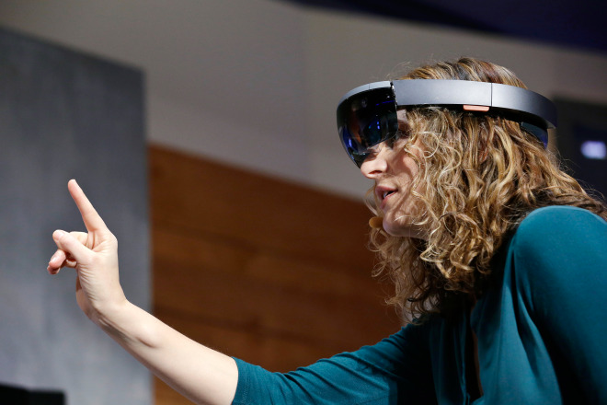
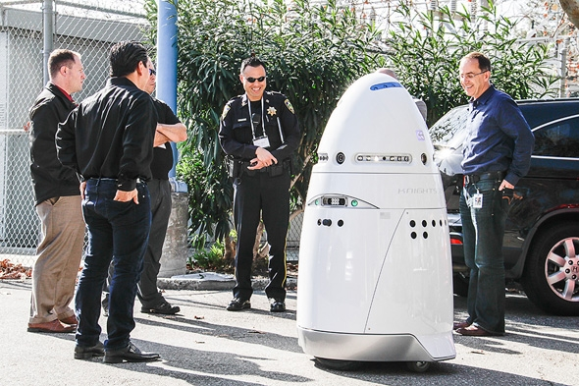
Cameras all around us
Mobile devices
Home entertainment
IoT and robotics
Notes:
Cameras have become a standard feature in many mobile devices and home entertainment system. A not-too-distant-future line of products for IoTs and robotics are designed with the capability of continuous recording. With cameras all around, confidential details of one’s personal life is always at risk.

Slide 3
Protecting visual secrets is hard.
Notes:
And for a common user, protecting these confidential details or visual secrets in the environment around her is an extremely tough task. I will give two examples to highlight the problem.

Slide 4
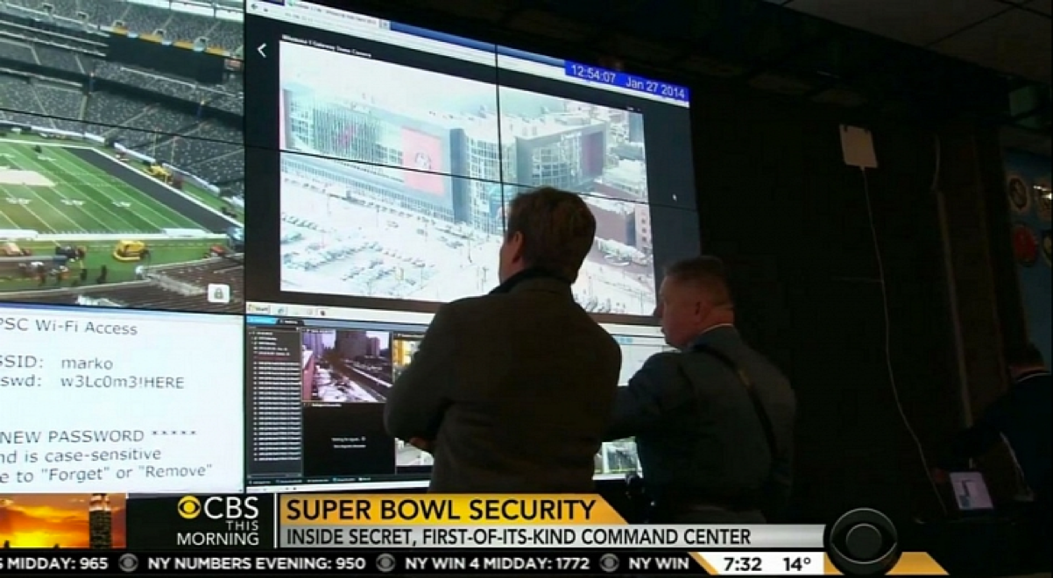
http://www.zdnet.com/article/super-bowl-wi-fi-password-credentials-broadcast-in-pre-game-security-gaffe/
Notes:
In 2014, during the pre-game coverage of super bowl 48, NFL invited CBS press to the stadium security center. During reporting from the security center, the news channel praised the security-center’s “First-of-its-kind” command center and at the same time captured this screen. This contained the stadium’s WiFi credentials and it was leaked to the whole world.

Slide 5
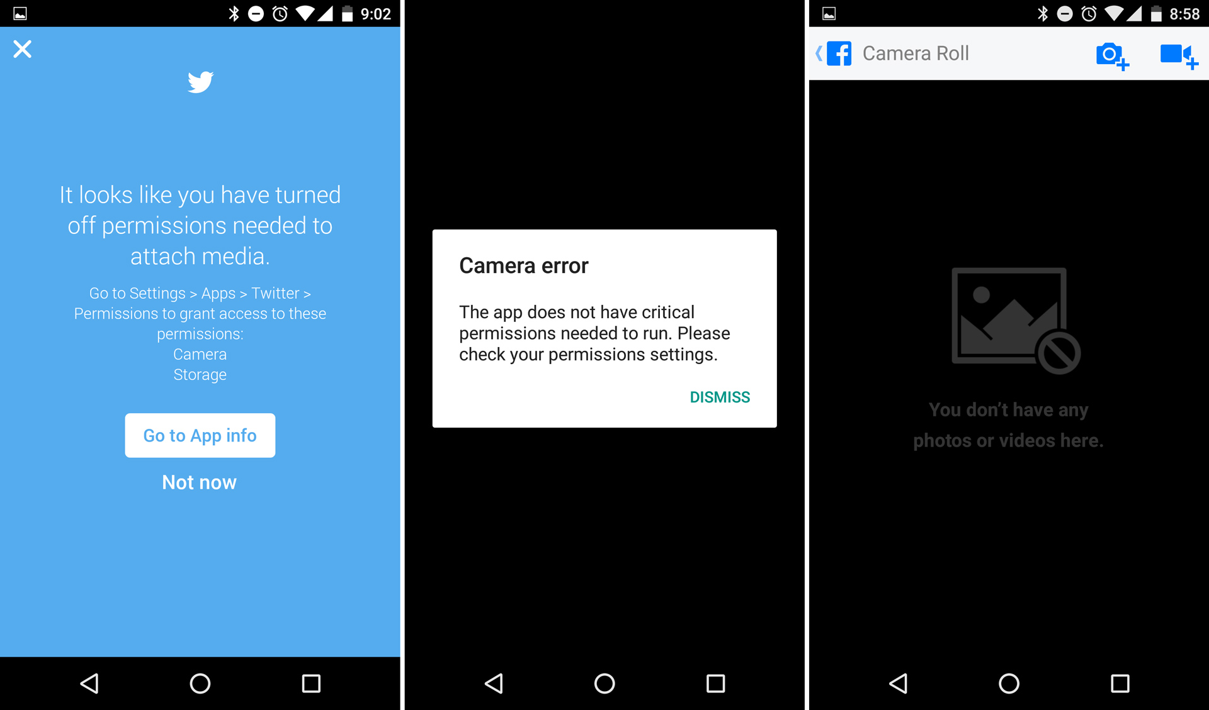
Coarse-grained control
App gets complete access or none
Notes:
These videos were not recorded on a mobile device. However, the problem remains the same. The current permission system is coarse grained. Either the app has access to all the visual information or none.

Slide 6

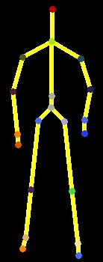

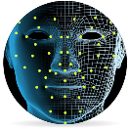
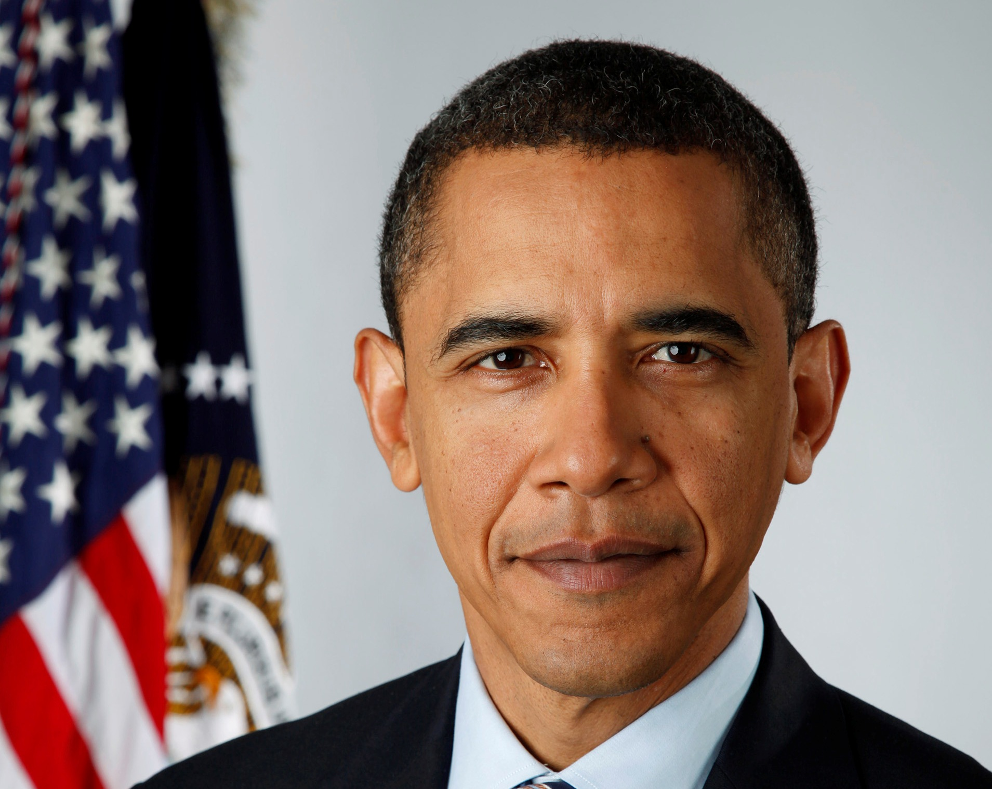
Fine-grained control
App
Privacy Framework
Per-app
policies
Recognizers
Detect objects (e.g., faces),
transform images
Notes:
Recent research has proposed fine-grained access control where the operating system is loaded with recognizers capable to recognize certain objects. Users can provide privacy policy to the system. The system enforces those privacy policies everytime an App access the camera data.

Slide 7
Fine-grained control
Recognizer [Usenix Security 2013]
WDAC [CCS 2014]
SurroundWeb [Oakland 2015]
I-Pic [MobiSys 2016]
Privacy Framework
Per-app
policies
Recognizers
Must anticipate objects.
Password recognizer?
Product-roadmap recognizer?
Notes:
Recognizers and I-Pic are few of the systems that provide such fine-grained access control. However, these approaches have some limitations. The major requirement for such a system to work is to have the App needs predefined so that the right recognizers can be built. The second problem with this approach is that it is very hard to create recognizers for any arbitray object. For example, it is not clear how to create a recognizer for a password.

Slide 8
Want general fine-grained control.
Notes:
We need to build fine grained access control for generic objects so that users have better control over the visual information that can be captured by camera.

Slide 9


Solution: privacy markers
Privacy markers
Fine-grained access control for visual info
Support arbitrary objects and surfaces
Two example systems: PrivateEye and WaveOff
PrivateEye
2D surfaces (e.g., whiteboards)
WaveOff
3D Objects (e.g., faces)
Notes:
Privacy makers allow users to protect arbitrary sensitive information in the environment. On a high level privacy markers consist of two parts: (a) simple interface for marking regions and (b) device softwares to recognize the markings. We have built two systems that embodies our principles of privacy markers.

Slide 10
Trust and attacker models
Assumptions
Recording-device hardware, system software is trusted
Third-party apps are untrusted
Trusted code isolated from untrusted code
Determined attackers can still capture secrets
Goal is preventing inadvertent leaks by apps
Notes:
We trust the hardware and the system softwares. All the third-party apps are considered untrusted. We assume that our privacy marker softwares are inside trusted systems completely isolated from untrusted code. Useful attacker model

Slide 11
Privacy-marker goals
Ease of use
Marking surfaces and objects should be convenient, easy
Reliable recognition
Secrets should be protected in face of motion, lighting, etc.
Good performance
Preserve legitimate app functionality
Notes:
Developing PrivateEye and WaveOff required several challenges to be tackled. We wanted to achieve the following three goals. The process of marking should be quick and easy and users should be able to mark any surface and object. Secrets must be protected across all the environments and scenarios. Third, our system should not affect app’s usability and should not limit its functionality.

Slide 12
Privacy-marker goals
Ease of use
Marking surfaces and objects should be convenient, easy
Reliable recognition
Secrets should be protected in face of motion, lighting, etc.
Good performance
Preserve legitimate app functionality
Notes:
Achieving each goal was a subproblem and now I will discuss how we solved them one by one.

Slide 13
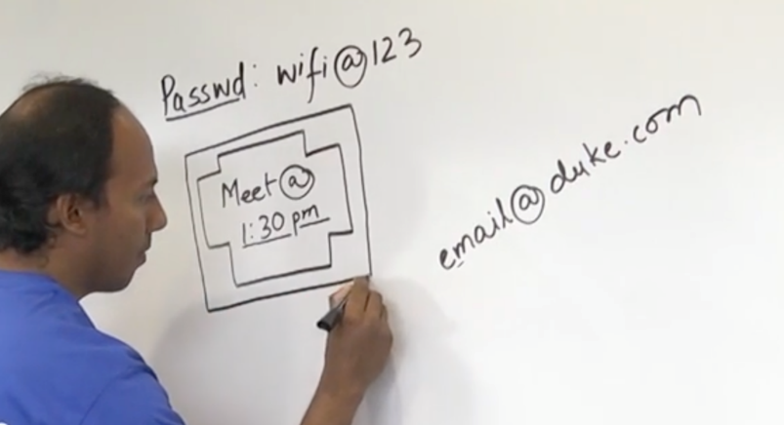
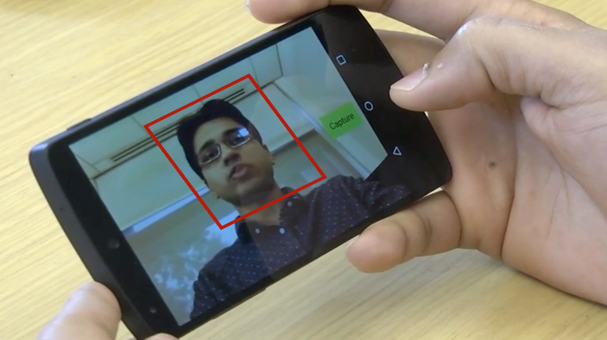
Ease of use
Marking must not require extra equipment
No RFID tags, QR codes, etc.
Rely on only device software and common office supplies
PrivateEye
WaveOff
Notes:
Ease-of-use was a primary goal for PrivateEye and WaveOff. Before arriving at our current designs, we considered alternatives, such as affixing or projecting QR codes onto surfaces and objects. However, we rejected such designs because they were very inconvenient. We chose a marking method where no special equipment was required. In case of PrivateEye, two concentric rectangles are used to mark. In case of WaveOff, a trusted UI is used to draw a bounding box around an object in order to mark it.

Slide 14
Ease of use
Marking must not require extra equipment
No RFID tags, QR codes, etc.
Rely on only device software and common office supplies
Draw special shape around region
(pens, presentation software, etc)
PrivateEye
Notes:
Ease-of-use was a primary goal for PrivateEye and WaveOff. Before arriving at our current designs, we considered alternatives, such as affixing or projecting QR codes onto surfaces and objects. However, we rejected such designs because they were very inconvenient. We chose a marking method where no special equipment was required. In case of PrivateEye, user draws a special shape around the 2d region.

Slide 15
Ease of use
Marking must not require extra equipment
No RFID tags, QR codes, etc.
Rely on only device software and common office supplies
External rectangle
PrivateEye
Notes:
The shape consists of an external rectangle.

Slide 16
Ease of use
Marking must not require extra equipment
No RFID tags, QR codes, etc.
Rely on only device software and common office supplies
Internal 12-sided polygon
PrivateEye
Notes:
And an internal 12-sided polygon.

Slide 17
Ease of use
Marking must not require extra equipment
No RFID tags, QR codes, etc.
Rely on only device software and common office supplies
Marked region
PrivateEye
Notes:
This whole region becomes the marked region. This marker is unusual and easy to draw, either by hand (e.g., using white- board markers) or using digital tools

Slide 18
Ease of use
Marking must not require extra equipment
No RFID tags, QR codes, etc.
Rely on only device software and common office supplies
Use trusted camera-preview UI
WaveOff
Notes:
In case of WaveOff, a trusted UI is provided and user draws a bounding box around an object in order to mark it.

Slide 19
Ease of use
Marking must not require extra equipment
No RFID tags, QR codes, etc.
Rely on only device software and common office supplies
Extract features w/i bounding box
WaveOff
Notes:
Once the marking is done, important features are extracted from the marked region and stored in memory for future matching

Slide 20
Privacy-marker goals
Ease of use
Marking surfaces and objects should be convenient, easy
Reliable recognition
Secrets should be protected in face of motion, lighting, etc.
Good performance
Preserve legitimate app functionality
Notes:
For reliable recognition our system relied on computer vision.

Slide 21
Reliable recognition
Computer vision often fails
Errors due to motion, occlusion, lighting
Cannot reliably block marked regions
Key design decision
Instead, whitelist marked regions
Bias toward security
Track markers to improve app utility
Notes:
Computer vision can fail for several reasons. In such cases security is at risk. We designed our system from a higher security perspective and chose whitelisting approach. Everything is considered sensitive and marked regions are considered public. If the system fails to recognize the markers, the public region/object gets blocked. This leads to drop in app utility but the system stays secure.

Slide 22
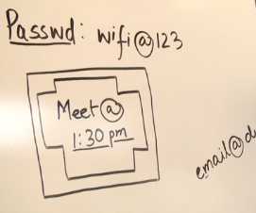
Reliable recognition
Privacy Framework
App
Per-app
policies
PrivateEye
Detect, whitelist marked regions

Slide 23
Reliable recognition
Privacy Framework
App
Per-app
policies
WaveOff
Detect, whitelist marked objects

Slide 24
Privacy-marker goals
Ease of use
Marking surfaces and objects should be convenient, easy
Reliable recognition
Secrets should be protected in face of motion, lighting, etc.
Good performance
Preserve legitimate app functionality

Slide 25
Good performance
Markers designed for quick detection
Detect contours if enough contrast with background
12-sided polygon with many right angles
Right angles + high-contrast lines
PrivateEye
Notes:
Quick detection of markers is important for good performance. Our markers are designed to play to the strength of computer vision. The PrivateEye markers is quickly detected due to the strong contrast of straight, dark lines on a light two-dimensional surface. Also, the right angles of the internal polygon makes the detection robust and fast.

Slide 26
Good performance
Markers designed for quick detection
Builds model for the object instead class of objects
BRISK features for fast and robust matching
Fast recognition and tracking
WaveOff
Notes:
WaveOff stores the features from the bounding box in memory and builds the model for the object. And it uses BRISK features as computing and matching BRISK features is efficient and is ideal for realtime performance on low-power mobile devices

Slide 27
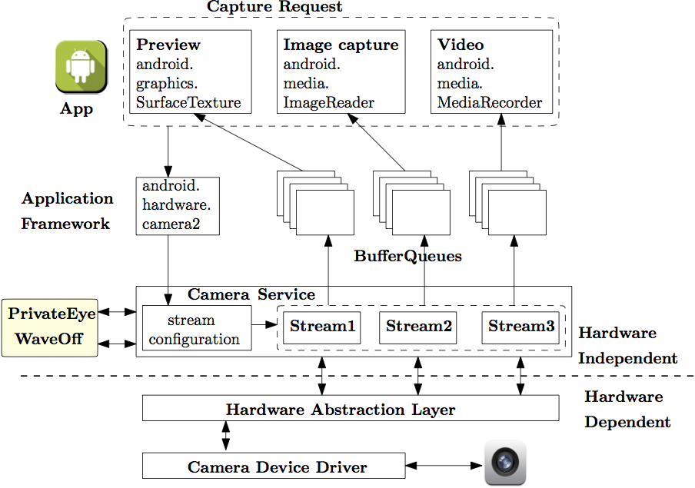
Android integration
Hardware
independent
PrivateEye
WaveOff
Hardware
dependent
Notes:
The camera subsystem is divided into two parts: hardware independent and hardware dependent layers. An App can place a capture request which goes through trusted camera service to the Hardware dependent layer. When the image is ready the data is handed back and camera service sends the data to the app. Since, camera service is trusted system service and a common interface between device driver and apps, we decide to plug our module with camera service.

Slide 28
Android integration
Naïve implementation led to poor performance
4 frames-per-second (FPS) video recording on Nexus 5
Multiple streams during video recording
Key observations:
Different streams have same data with different settings
Higher throughput with non-blocking operations
Optimizations led to a median rate of 22 FPS delivery
More details in the paper

Slide 29
Evaluation
Ease of use
Performed 26-person user study
Reliable recognition
Precision, recall with video benchmark
Good performance
FPS with video benchmark
Notes:
We proceeded to evaluate how well we achieved our goals. We conducted a 26 participant user study to understand the usability of our systems. We measured precision and recall to measure the accuracy of our system’s recognition. And we measure frames per second delivery to understand the performance.

Slide 30
User study
Task: Scan QR code on 2D and 3D surfaces
Used third-party BarCode Scanner app
2D surface was a whiteboard
3D surface was a coffee mug
26 participants divided in two groups
Control group - stock camera on unmodified Android
Case group - PrivateEye and WaveOff enabled Android

Slide 31
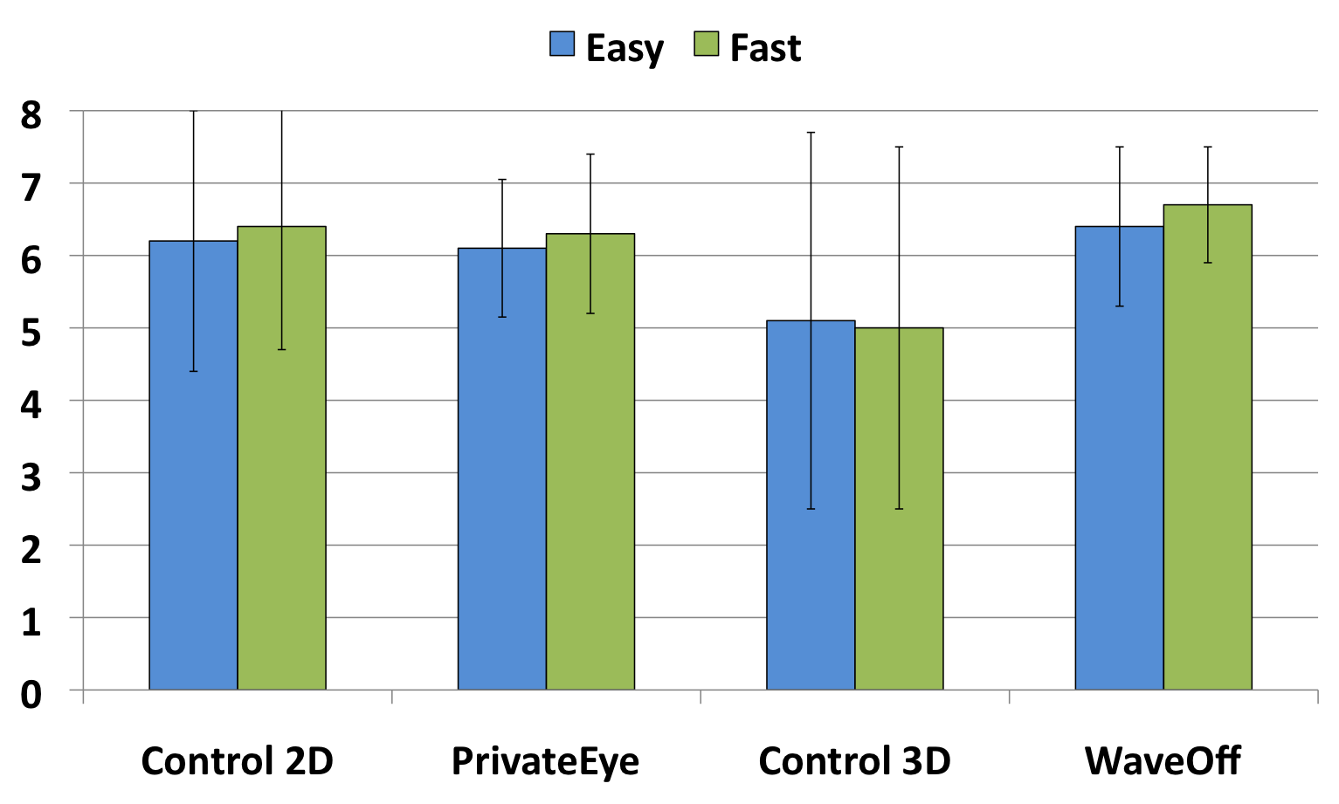
User study feedback
Case and control rated similarly
(higher is better)

Slide 32
User study feedback
Note: WaveOff better rated than control app!

Slide 33
Recognition evaluation
Video benchmark under different scenarios
10 sec. long videos with resolution 1280x960
Each video combined a setting and motion
Divided video frames into cells, labeled each public or private
Three settings
2D/PrivateEye – Whiteboard, paper, laptop screen
3D/WaveOff – Plain background, nearby object, nearby PC
Three camera motions
Still – simulates image capture
Spin – to understand the impact of change in orientation
Scan – simulates a video recording

Slide 34
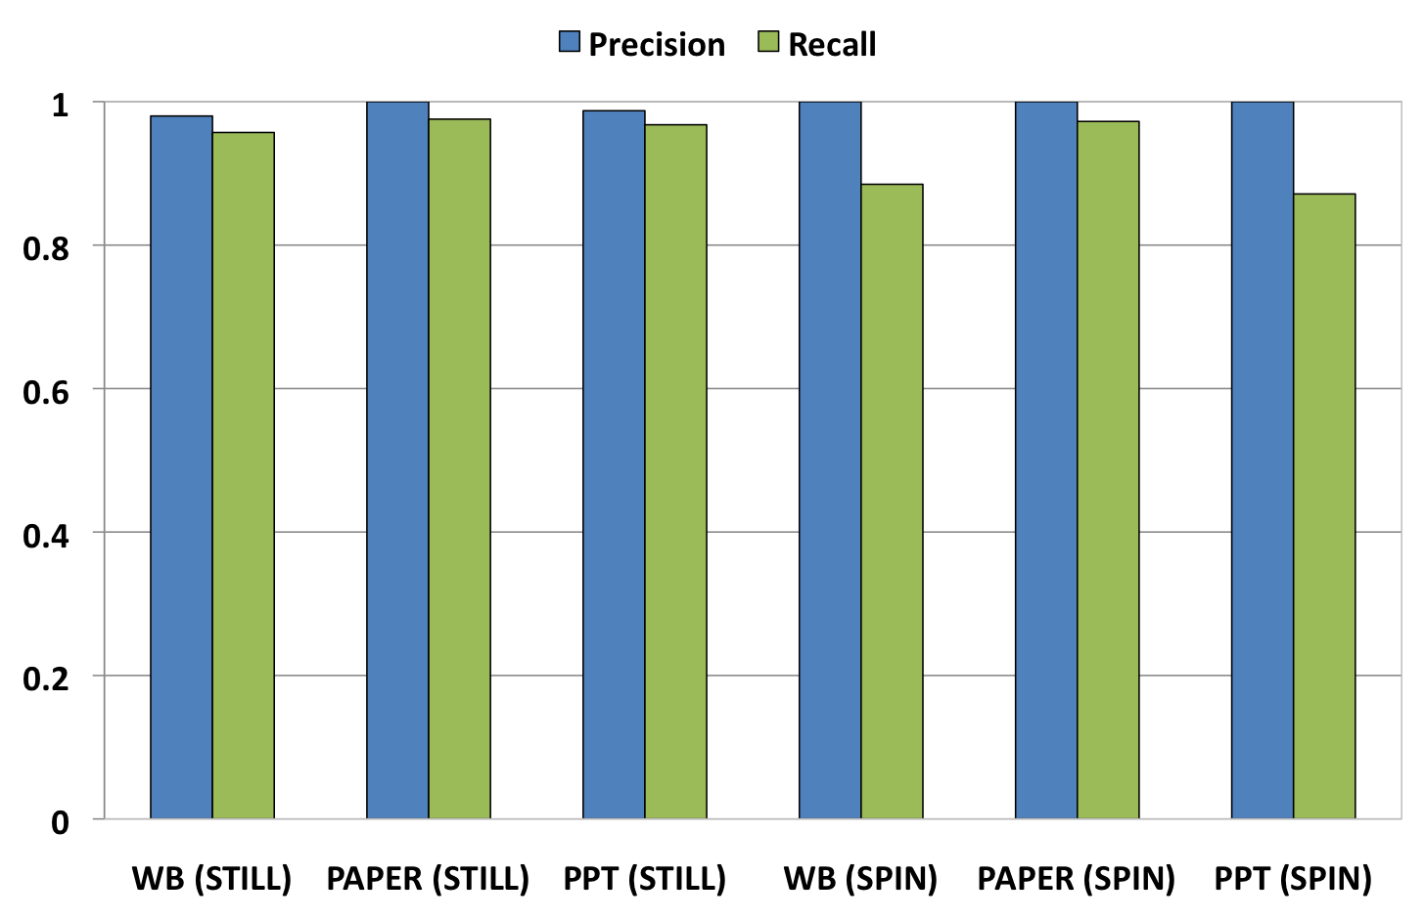
PrivateEye recognition
Near perfect precision
(better security)

Slide 35
PrivateEye recognition
Drop in recall due to motion blur

Slide 36
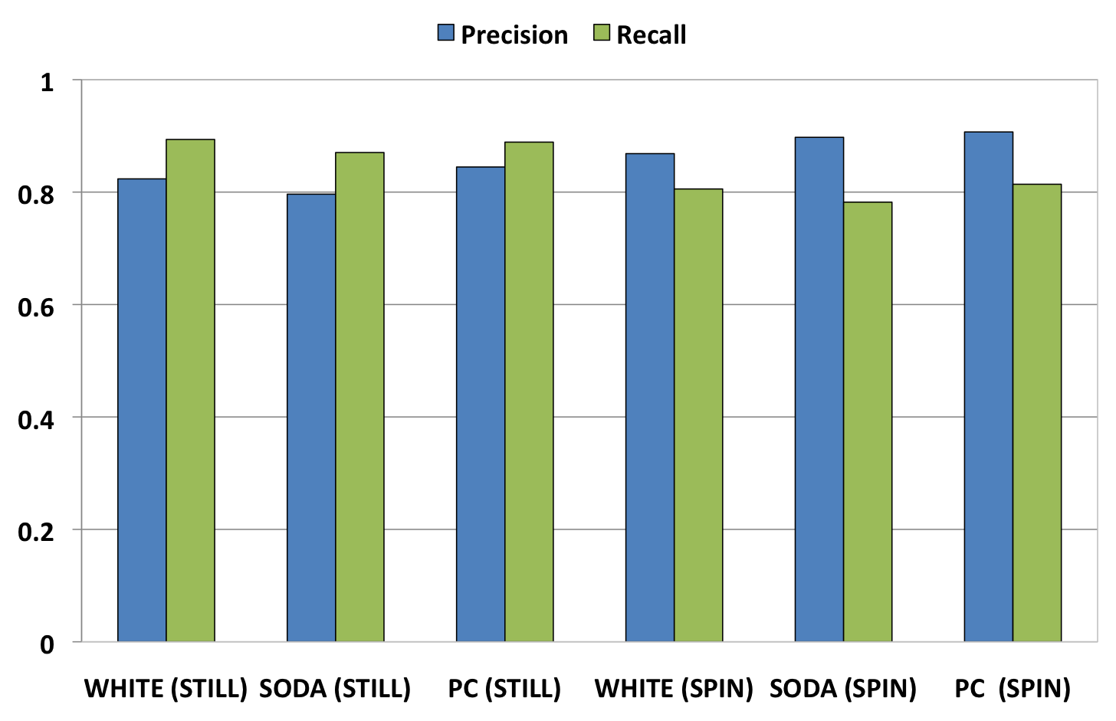
WaveOff recognition
Irregular shape leads to lower precision and recall

Slide 37
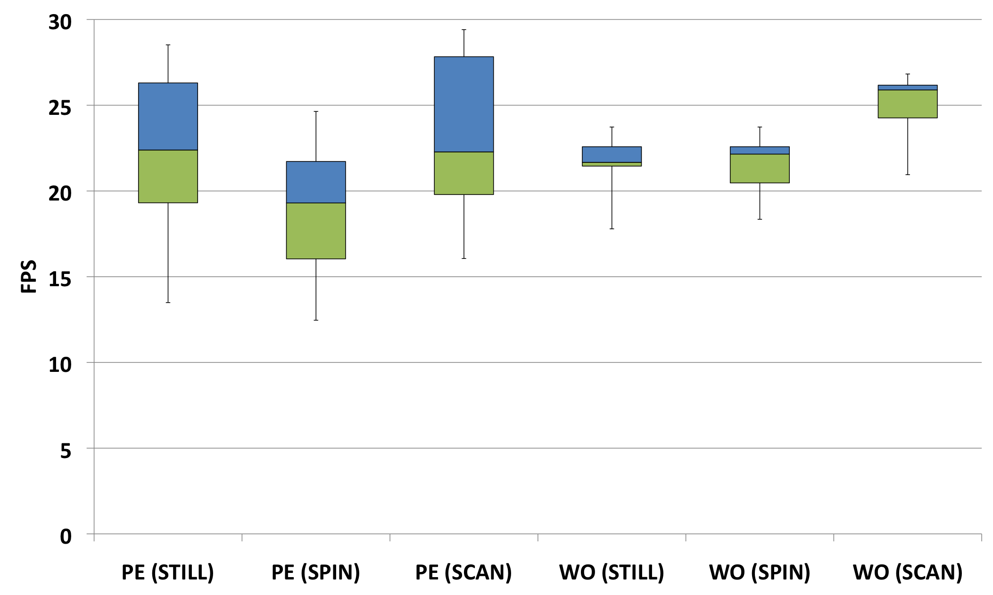
Performance results
Median FPS between 20 and 25 (4 FPS before optimizations)

Slide 38
Limitations
Rectangular markings are required
May cause leaks at the edges
Markers should be tightly drawn
Camera may zoom inside the marked regions
The system will block the view
Marked regions are public for all the apps
No apps based policy

Slide 39
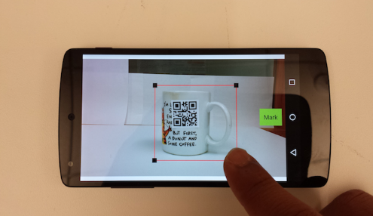
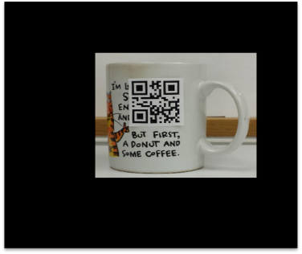
Summary
What you mark
Privacy markers
General fine-grained control
Example systems: PrivateEye, WaveOff
Whitelist approach
Computer vision is unreliable
Bias towards security
Prototype evaluation
Positive user-study feedback
Good precision, recall, throughput
Future
Other sensing modalities (audio, motion)?
More complex policies?
What apps see
Notes:
User study deemed our system fast and easy to use. Our measurements show that our system has acceptable precision and recall.
This work leads to interesting future directions: how can we apply the privacy marker techniques to other sensing modalities such as audio.
Also, another interesting direction would be to think about marker design that can encode complex policies.

